Slide 1

Vincennes University
Structure Emergency Plan
PE COMPLEX
Vincennes Campus
SEP
2021

Slide 2

PE Complex Overview
Vincennes University
Structure
Emergency
Plan
SEP Basic Information
Structure Contact Information
Any Critical Operations
Notification Procedures
  Emergency and Non Emergencies
  Emergency Warning Notification System
Emergency Procedures
Evacuation Procedures
  Structure Specific
  Emergency Assembly Area
  Guidelines for People with Disabilities
Shelter In Place Procedures
Points of Contact
PE COMPLEX
Vincennes Campus
SEP

Slide 3
Your Structure Emergency
Plan (SEP)
Vincennes University
Structure
Emergency
Plan
Designed to provide students, faculty, staff, and guests information about:
  - Shelter in place and Evacuation procedures for natural & human-caused events.
REMEMBER, WHEN YOU HEAR:
  ALL HAZARDS SIRENS immediately seek shelter (Shelter-In-Place) in a safe location within the closest facility.
  FIRE ALARMS immediately evacuate the building and move to you Emergency Assembly Area (EAA).
In both cases, you should solicit additional clarifying information by all possible means…Vincennes University Homepage, TV, radio, email, etc.
PE COMPLEX
Vincennes Campus
SEP

Slide 4
PE Complex
Structure Emergency Plan
Vincennes University
Structure
Emergency
Plan
As a building occupant, you need to be familiar with your specific structure emergency plan. Read it carefully. If you have any questions, consult your Building Manager, Department Safety Coordinator or Safety Committee representatives.
Be familiar with the VU Emergency Management Plan attached to your VUSEP. It is also located at:
https://www.vinu.edu/group/guest/emergency-information
PE COMPLEX
Vincennes Campus
SEP

Slide 5
PE Complex
Structure Emergency Plan
Vincennes University
Structure
Emergency
Plan
Know the following:
  The Vincennes University Emergency Warning Notification System
  Evacuation routes, exit points, and where to report for roll call after evacuating (aka Emergency Assembly Area or EAA)
  When and how to evacuate the building
  Safe locations to shelter in place
  Locations of emergency materials that may be needed in an emergency such as fire pull alarms
  Procedures for notifying emergency responders…dial 911 for any emergency
  Additional building specific procedures and requirements
Your VUSEP is available at division offices, building administrative offices and the campus police.
PE COMPLEX
Vincennes Campus
SEP

Slide 6
Building Contact Information
Vincennes University
Structure
Emergency
Plan
Building Name: Physical Education Complex
Building Manager: Michael Taylor
Email: mtaylor@vinu.edu
Address: 1600 Short Street Vincennes, IN 47591
Office #: 812-888-4957
Cell #: 812-899-2200
Alternate Building Manager: Earl Potter
Email: earl.potter@vinu.edu
Office #: 812-888-5470
Cell #: NA
PE COMPLEX
Vincennes Campus
SEP

Slide 7
Building Critical Operations
Vincennes University
Structure
Emergency
Plan
There are no critical operations at the Red Skelton Performing Arts Center.
  Critical operations are defined as any potentially hazardous operations located in your facility that requires preplanning for evacuation and/or shelter in place events.
  This information must be readily available to First Responders to assist them in their emergency response.
PE COMPLEX
Vincennes Campus
SEP

Slide 8
Notification Procedures
Vincennes University
Structure
Emergency
Plan
Immediate Emergency Notification: Dial 911 from a public or campus telephone.
For Non-Emergency Notifications call:
  Building Manager Phone Number: 812-888-4957
- Alternate Building Manager: 812-888-5470
  Vincennes University Police Department: 812-888-5555
  Vincennes Fire Department: Call Campus Police @ 812-888-5555
  VU Environmental Safety: 812-888-4227
  Physical Plant Services: 812-888-4227
PE COMPLEX
Vincennes Campus
SEP

Slide 9
Emergency Warning Notification
Vincennes University
Structure
Emergency
Plan
All-Hazards Emergency Warning Sirens (Shelter-In-Place)
Fire Alarms (Evacuate the Building)
Vincennes University E-Alert
    An e-mail will be sent to all people with a vinu.edu address.
      Building Managers begin their internal notification procedures once the mass e-mail is received. This could be specific information that needs “pushed out” to Assistant Managers or specific people. The Assistant Managers, or authorized person will then forward the email to others in the building or go to offices or rooms in person. Signs may be posted on doors on in hallways.
PE COMPLEX
Vincennes Campus
SEP

Slide 10
Emergency Warning Notification
Cont.
Vincennes University
Structure
Emergency
Plan
    VU Faculty, Staff, and Students will receive an emergency notification via text and/or voice message during certain situations or emergencies.
Smart Classroom “Screen Takeover”
    Classrooms with a smart podium that are equipped with an Emergency Panic Button will receive important messages via a “Screen Takeover” in certain situations and/or emergencies that are specific to that area or building.
The Housing Office will be notified. They in turn will activate their procedures to alert people in individual Residence Halls.
PE COMPLEX
Vincennes Campus
SEP

Slide 11
Emergency Warning Notification
Cont.
Vincennes University
Structure
Emergency
Plan
The VU Homepage (www.vinu.edu) is the focal point of the most complete information in all campus related emergencies.
VU External Relations will work with news media (radio, TV, newspapers, and internet) to help get information out.
    Do Not speak to or release anything to any media source or outlet unless you are given specific permission to do so.
    The WVUB Emergency Notification System will broadcast emergency information.
Information will be posted on Vincennes University Social media groups.
PE COMPLEX
Vincennes Campus
SEP

Slide 12
Evacuation Procedures
Vincennes University
Structure
Emergency
Plan
If you hear the fire alarm or are told to leave the building:
    Evacuate Immediately upon notification
    No one can remain; classes must evacuate
    Take coats, purses, keys. You will not be allowed back in until the Emergency Responders authorize re-entry
    Notify others on your way out
    Close doors as you leave
PE COMPLEX
Vincennes Campus
SEP

Slide 13
Evacuation Procedures
Cont.
Vincennes University
Structure
Emergency
Plan
    Help anyone needing assistance
    Use stairways only …. Do Not use elevators
    Report to your Emergency Assembly Area (EAA) for accountability and further instructions.
        Do not leave the EAA unless instructed to
    Do not re-enter the building until authorized by Police/Fire Department Personnel
PE COMPLEX
Vincennes Campus
SEP

Slide 14
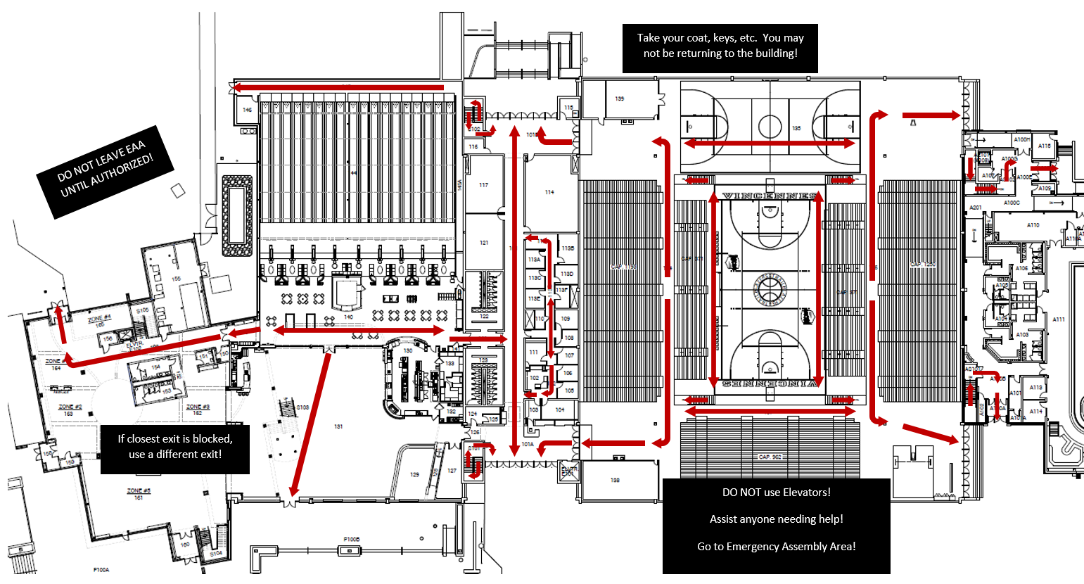
First Floor Evacuation Plan
Vincennes University
Structure
Emergency
Plan
PE COMPLEX
Vincennes Campus
SEP

Slide 15
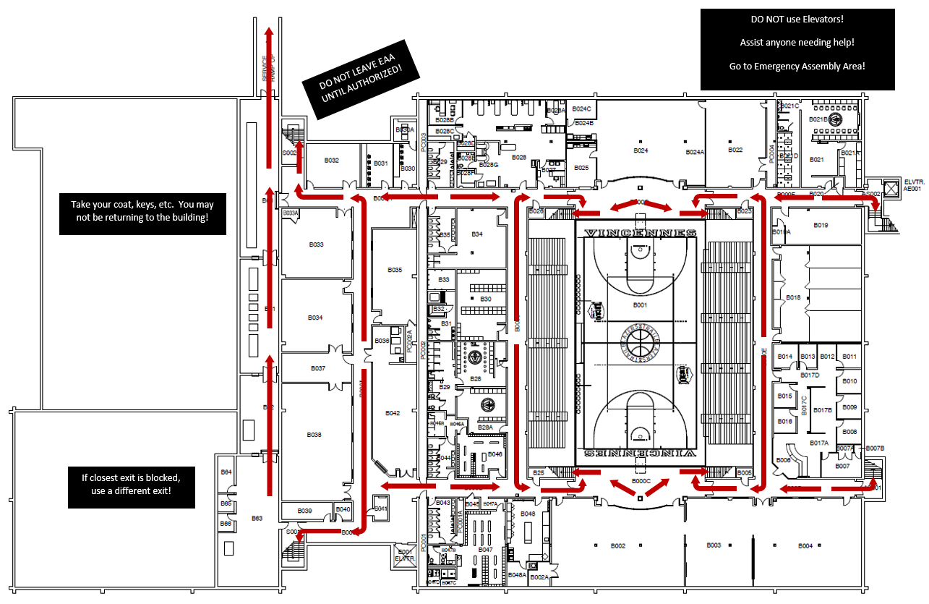
Basement Evacuation Plan
Vincennes University
Structure
Emergency
Plan
PE COMPLEX
Vincennes Campus
SEP

Slide 16
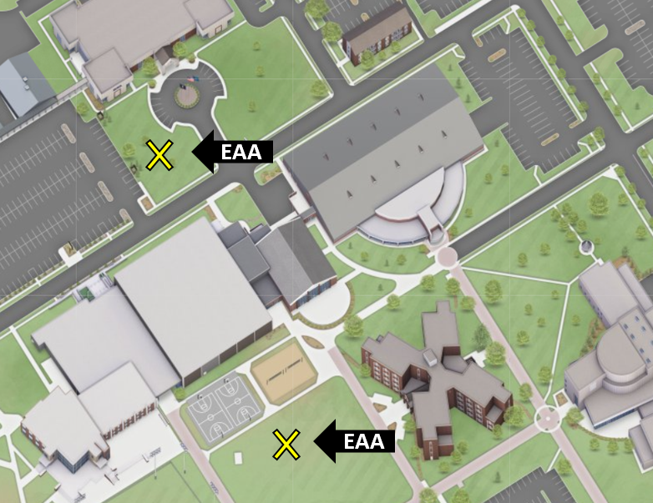
Emergency Assembly Area
Vincennes University
Structure
Emergency
Plan
The Emergency Assembly Area (EAA) is used as a rally point for instructors and the building manager to check that all people have evacuated the building. Do not leave the EAA until instructed by the Building Manager or Emergency Responders!
PE COMPLEX
Vincennes Campus
SEP

Slide 17
Emergency Assembly Area
Cont.
Vincennes University
Structure
Emergency
Plan
All people evacuating a building must report to one of the two EAAs, based on your evacuation route from the building.
Once at the EAA, the head of each department MUST take roll call and account for everyone. We must identify if someone is still inside the building.
    This is crucial for the Emergency Responders
Stay in the EAA until released by Building Manager or Emergency Responders.
Cars and personal property can be replaced.
    You cannot
PE COMPLEX
Vincennes Campus
SEP

Slide 18
Shelter-In-Place
Vincennes University
Structure
Emergency
Plan
Types:
    Tornado Warning / Other Severe Weather Events
    HAZMAT Situation
    Active Shooter, Violent Intruder, Civil Disturbance
When to Shelter:
    When you hear the All Hazards Sirens
    When directed to by Police/Fire Personnel, Building Manger, Faculty, and/or Staff
    Anytime you receive indication of an unsafe environment (heard gunshots, see a person with gun, etc.) and shelter-in-place is your best and safest option over evacuation.
Where to Shelter:
    This will be determined by the nature of the event.
    The most common is Tornado Warnings or Sever Weather Events in which 1st floor restrooms may be used, the basement may be used (under main stage and under museum), the dressing rooms may be used, the faculty hallway may be used, and the theatre lab may be used
PE COMPLEX
Vincennes Campus
SEP

Slide 19
Shelter-In-Place Procedures
Vincennes University
Structure
Emergency
Plan
Tornados / Other Severe Weather Event
    Take refuge in nearest 1st floor restroom, or the basement under the facility
    Help visitors or physical disabled people
    Be prepared to kneel facing a wall and cover your head
    Try and obtain additional clarifying information by all possible means (VU webpage, TV, radio, e-mail, cell phone, etc.)
    Do not leave until given an “ALL CLEAR”
PE COMPLEX
Vincennes Campus
SEP

Slide 20
Shelter-In-Place Procedures
Cont.
Vincennes University
Structure
Emergency
Plan
HAZMAT Event
    Shelter in your classroom if deemed appropriate or take refuge in nearest 1st floor restroom or in the basement of the facility. Do Not use an elevator.
    Help visitors or physical disabled people if moving
    Close all windows and doors
    Key people will turn off Heating and Air Systems (HVAC)
        Needs done in one (1) location
    Try and obtain additional clarifying information by all possible means (VU webpage, TV, radio, e-mail, cell phone, etc.)
    Do not leave until given an “ALL CLEAR”
PE COMPLEX
Vincennes Campus
SEP

Slide 21
Shelter-In-Place Procedures
Cont.
Vincennes University
Structure
Emergency
Plan
Active Shooter, Violent Intruder, Civil Disturbance
    ALICE: (Alert / Lockdown / Inform / Counter / Evacuate)
        Training offered twice annually on VU Campus
    If possible evacuate or take refuge in a room that can be secured.
    If possible, close and lock the building’s or room’s door(s). If unable to lock the door secure it by any means possible (Barricade the Doors).
    The room should also provide limited visibility to anyone that is outside of it. Cover windows quickly if you can. Stay out of view whenever possible.
    Hide under a desk, in a closet, or in the corner, but have an escape plan.
    After getting to a safe location and without jeopardizing your safety, try and obtain additional clarifying information by all possible means (e.g. Vincennes Homepage, TV, radio, email, etc.)
PE COMPLEX
Vincennes Campus
SEP

Slide 22
Shelter-In-Place Procedures
Cont.
Vincennes University
Structure
Emergency
Plan
  Report any suspicious activity if you can do so without jeopardizing your safety…Call 911 if possible.
  At any time during an active shooter or violent intruder situation, evacuate if this can be done safely and quickly.
  Prepare to counter (attack) the intruder if necessary. If at any time, you come in contact with the shooter or violent intruder, and you cannot escape or evacuate, make yourself a hard target (MOVE), react (THROW OBJECTS), use any means necessary and improvise a defense to distract or disable the shooter. If possible, multiple people can quickly swarm, secure, and disarm an active shooter.
  MOST IMPORTANTLY: DO SOMETHING
PE COMPLEX
Vincennes Campus
SEP

Slide 23
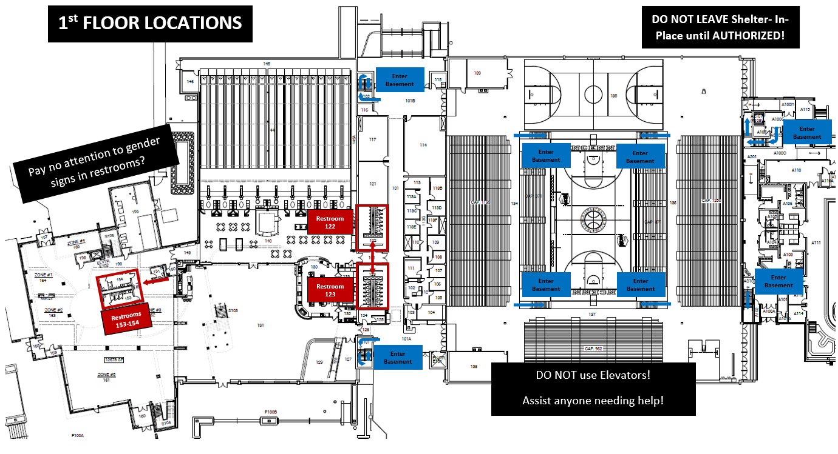
Shelter-In-Place Locations
Vincennes University
Structure
Emergency
Plan
PE COMPLEX
Vincennes Campus
SEP

Slide 24
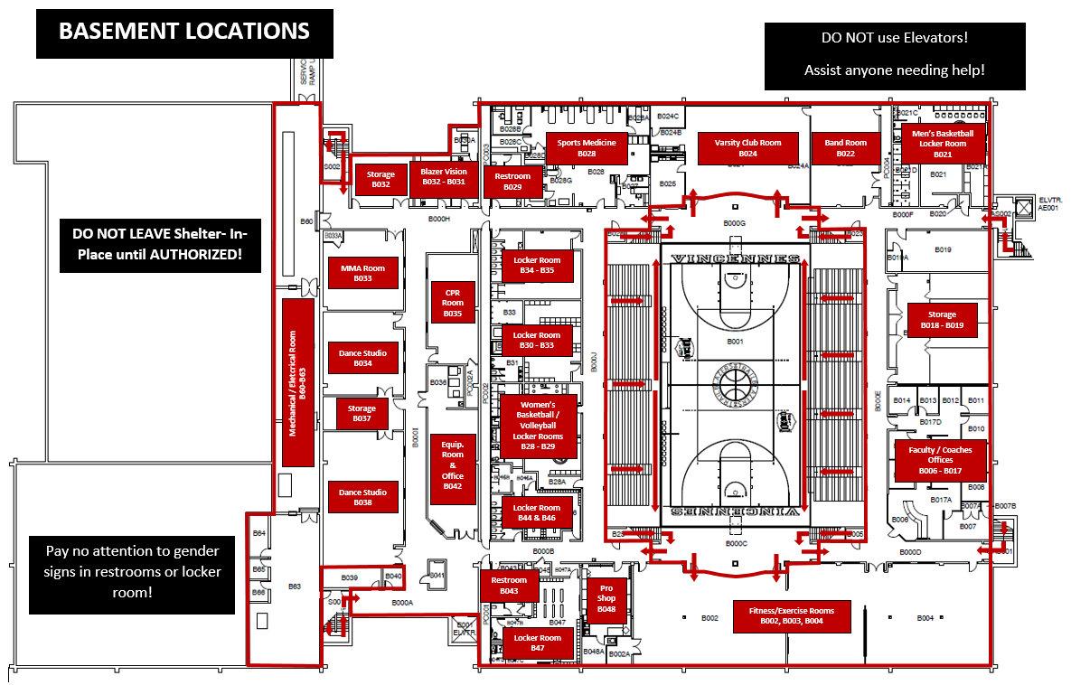
Shelter-In-Place Locations
Cont.
Vincennes University
Structure
Emergency
Plan
PE COMPLEX
Vincennes Campus
SEP

Slide 25
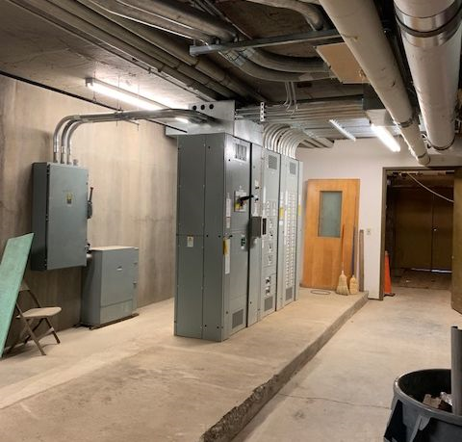
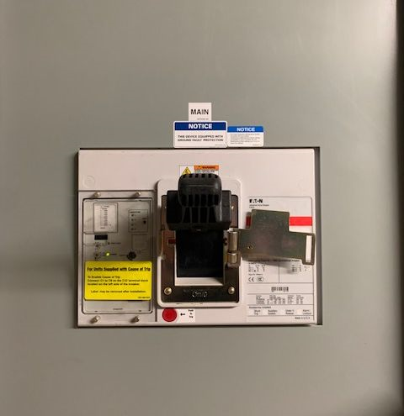
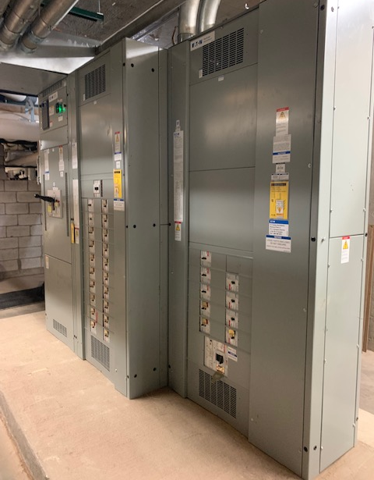
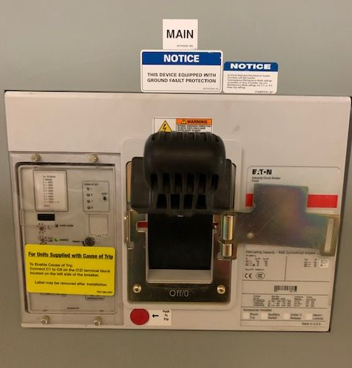
HAZMAT Incident
Vincennes University
Structure
Emergency
Plan
Where to Turn Off HVAC
SWITCH LABELED | LOCATION
MAIN (480) (HVAC) | West Side Tower of Electrical Room (B60) - located in Basement (Figure 1.1 & Figure 1.2) KILLS POWER TO ALL HVAC AND OTHER HIGH VOLTAGE EQUIPMENT (GYM LIGHTS)
MAIN (208) (Remaining Power) | East Side Tower of Electrical Room (B60) - located in Basement (Figure 1.3 & Figure 1.4) KILLS ALL REMAINING POWER IN THE BUILDING
Figure 1.1
Figure 1.2
Figure 1.3
Figure 1.4
PE COMPLEX
Vincennes Campus
SEP

Slide 26
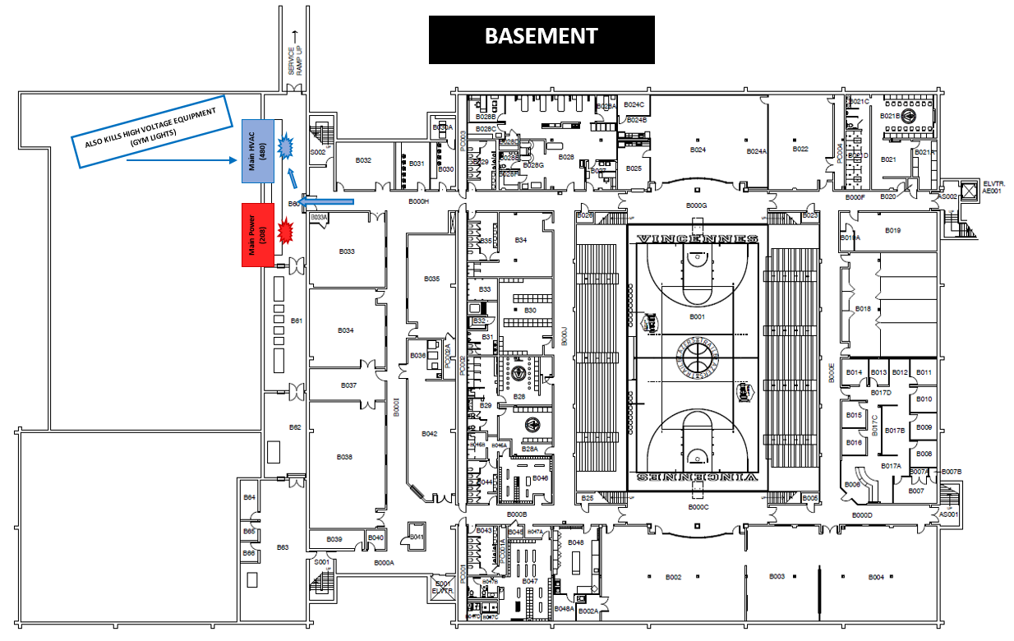
HVAC Locations
Vincennes University
Structure
Emergency
Plan
PE COMPLEX
Vincennes Campus
SEP

Slide 27

QUIZ
Vincennes University
Structure
Emergency
Plan
  What is this sound and what do you do if you hear this sound?
PE COMPLEX
Vincennes Campus
SEP

Slide 28
QUIZ
Cont.
Vincennes University
Structure
Emergency
Plan
  Where is the Emergency Assembly Area for your building located?
PE COMPLEX
Vincennes Campus
SEP

Slide 29
QUIZ
Cont.
Vincennes University
Structure
Emergency
Plan
  What are these indicating?
    Dark, often greenish sky
    Large hail
    Load roar, similar to a train
    Cloud of debris
    Wind becomes calm and still
    Frequent lightening
PE COMPLEX
Vincennes Campus
SEP

Slide 30
QUIZ
Cont.
Vincennes University
Structure
Emergency
Plan
  What is this sound and what do you do if you hear this sound?
PE COMPLEX
Vincennes Campus
SEP

Slide 31
QUIZ
Cont.
Vincennes University
Structure
Emergency
Plan
  What is this sound and what do you do if you hear this sound?
PE COMPLEX
Vincennes Campus
SEP

